Slide 1
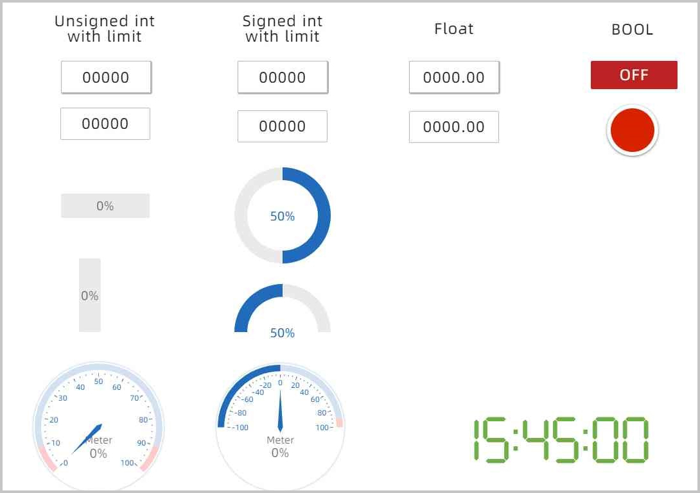
Team OFKRse HMI Data Acquisition
All

Slide 2
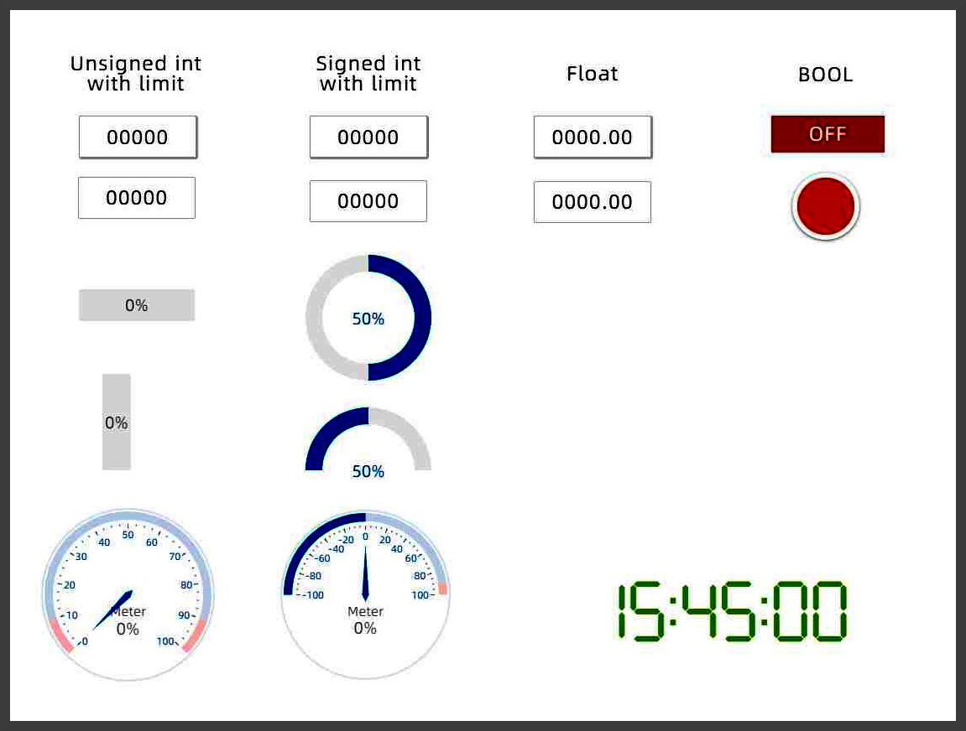
Project Details
This project requires the development of computer software that can remotely monitor data displayed on an HMI (Human Machine Interface).
Goals of the project are as follows
Read values on an HMI screen
Detect changes in values
Relay those changes to the user
Compile all developed software into an easy-to-install package
FC

Slide 3
Project Details Cont’d
Domain of project includes:
Using the included VNC software to establish a connection to the HMI
Creating software that monitors each aspect of the HMI for changes
Segmenting the HMI screen up and reading and relaying information to a user
The Project Users will be the Floor Manager and the Machine Operator.
The Floor manager will receive reports of relevant changes
The Machine Operator will be able to monitor the proper functioning of the industrial equipment
FC

Slide 4
VNC Screenshot
KP

Slide 5
01
Functional Requirements
1. VNC Connection to remote equipment
2. Screen Capture
3. Image Segmentation
4. Data Extraction and Comparison
5. Data Logging
KP

Slide 6
Functional Requirements: Details
1. VNC Connection
- Establish a connection to the HMI VNC server
- Handle connection errors
2. Screen Capture
- Periodically capture screenshots of the HMI
- Store screenshots for processing -- and later reuse
KP

Slide 7
Functional Requirements: Details
3. Image Segmentation
- Segmentation of captured screenshots into individual HMI elements based on user-defined parameters in a configuration file
KP

Slide 8
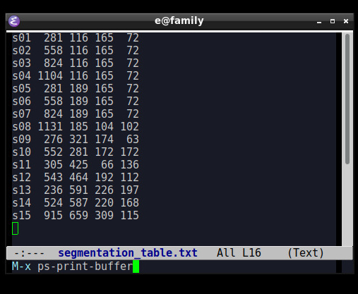
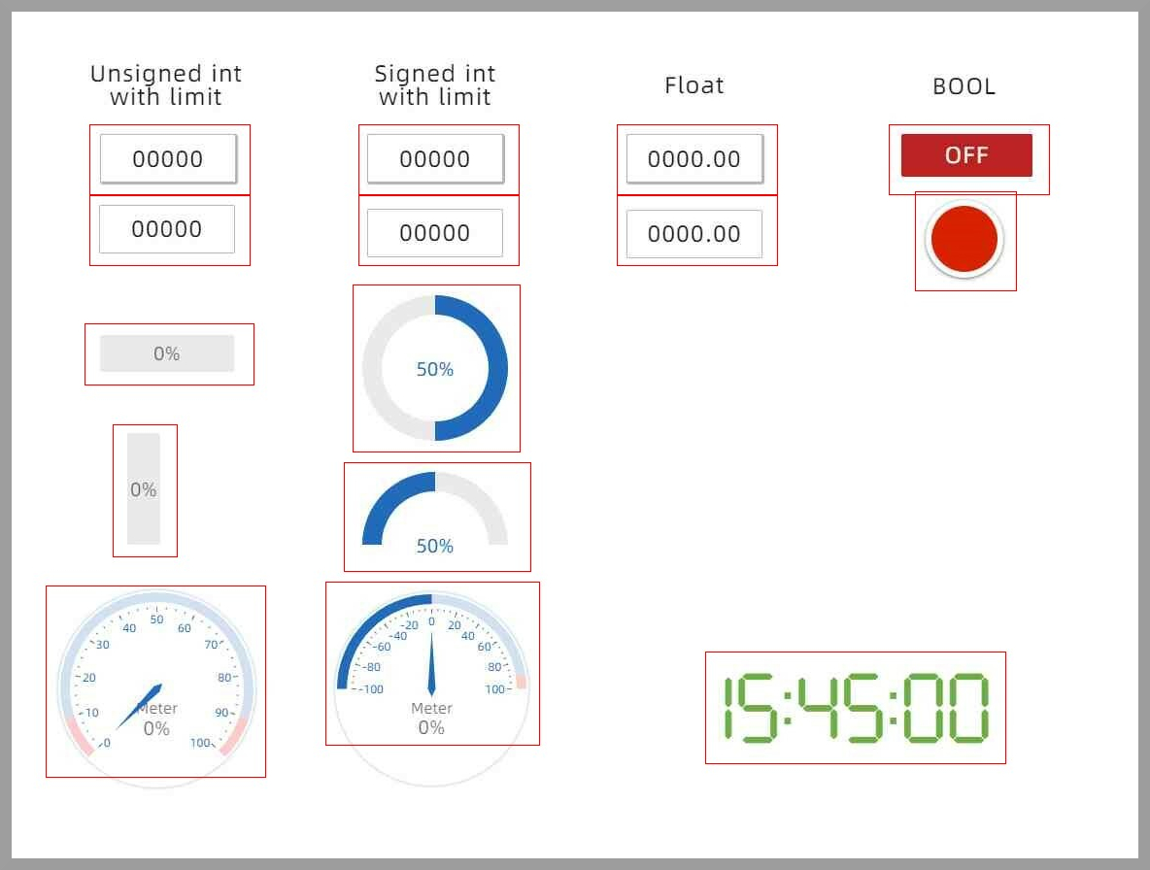
Image Segmentation
KP

Slide 9
Functional Requirements: Details
4. Data Extraction and Analysis
- Read numeric values and strings from segments
- Detect switch status (ON/OFF)
- Recognize indicator light color (convert to string)
- Stretch goal: Convert gauge pointer positions to values
- Stretch goal: Convert slider positions to numerical values
- Stretch goal: Convert bar charts to numerical values
- Store extracted data for displaying -- and future data-mining
KP

Slide 10
Functional Requirements: Details
5. Data Comparison and Logging
- Compare each current extracted value with the previous value to detect changes
- Log extracted information regarding changes in a corresponding change log file
- For segments where data cannot be currently extracted, detect image changes, if any present
KP

Slide 11
02
Functional Requirements
6. Data Display
7. Alert System
8. Data Archiving, Preparing Reporting
9. Documentation, Installation Packaging
10. Stretch Goal: Webcam Integration
RB

Slide 12
Functional Requirements: Details
6. Displaying Data on User Interface
- Implement a HTML interface for easy visual data and image display
- Periodically update the UI display in user-defined intervals
RB

Slide 13
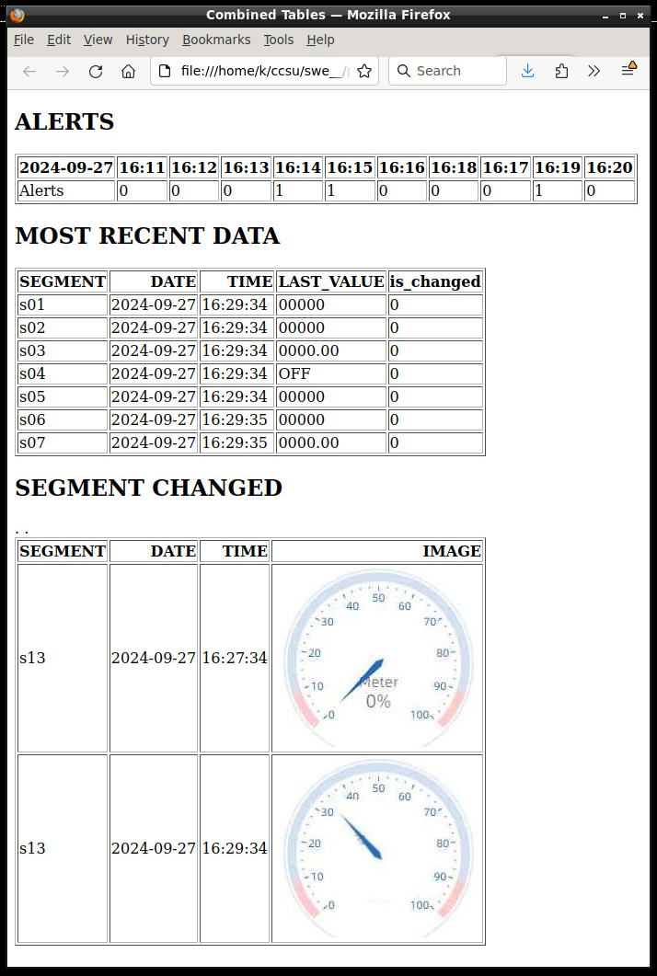
User Interface
RB

Slide 14
Functional Requirements: Details
7. Alert System
- Define minimum and maximum thresholds for monitoring variables: only report significant changes
- Trigger alerts when values fall outside predefined thresholds
- Display the alerts in the UI
- Additionally email an alert notifications with description of the detected change
- Log all alert events in an alert log file
RB

Slide 15
Functional Requirements: Details
8. Data Archiving and Reporting
- Archive registered values and alerts
- Allow users to access and view historical data
- Optional: Generate actionable reports summarizing equipment operation
9. Installation and Documentation
- Prepare an easy-to-install package
- Provide documentation on installation and software usage
RB

Slide 16
Functional Requirements: Details
10. Optional Stretch Goals: Camera Integration
- Capture frames generated by a webcam aimed at the physical HMI
- Optimize the extracted image for recognition to account for various factors such as camera angle, camera shake, changes in ambient light, etc.
- Implement functionality to generate various reports by analyzing raw data from log files and alert logs
RB

Slide 17
01
Non-Functional Requirements
The time required between capturing a screenshot and updating the data display should preferably be under one minute.
A threshold for an acceptable error rate interpreting segments – TBD by the project owner
We will aim for at least 90% success rate to start
Intuitive and simple UI requiring minimal operator training. Establishment of policy to filter out noise and data from small changes
OA

Slide 18
02
Non-Functional Requirements
The monitoring system should be compatible with common HMI software and hardware used in industrial settings.
The system should store HMI readings and screenshots for at least 7 days for auditing and analysis purposes.
The VNC connection to the HMI server residing on the equipment must be password protected.
The HTML page interface should be responsive and compatible with major browsers (Chrome, Firefox, Safari, Edge) on both desktop and mobile devices.
OA

Slide 19
Highlights of the Product Backlog
01
02
03
04
-Planned Graphical User Interface with the elements displaying changes and alerts
-Detect changes and send notification via email
-Image segmentation and data extraction
-Showing raw data with images for visualization
OA

Slide 20
Sprint Planning Strategies (1)
Task Break Down:
Communicate with Stakeholders:
-Divide epics into smaller, manageable user or developer stories.
-Assign story points to each story based on complexity.
-Consider dependencies on previously completed tasks.
-Create a sprint backlog.
-Keep stakeholders informed about potential bottlenecks.
-Modify the sprint plan based on new information.
OA

Slide 21
Sprint Planning Strategies (2)
Timeboxing:
Goal-Oriented Planning:
-Prioritize discussions, avoid sidetracks
-Set a time limit for the sprint planning meeting (e.g. 30 minutes)
-Define a concise and achievable objective for the sprint
-Align sprint tasks with the final goal
OA

Slide 22
Sprint Planning Strategies (3)
Refinement:
Visualization:
-Encourage feedback from stakeholders and team members.
-Learn from past sprints (retrospectives).
-Use a visual aid, such as GitHub Projects, to create a visual backlog and track progress.
OA

Slide 23
Lessons Learned
Virtual
Teammates
Meetings
Be Specific
-Working with a VNC and remote desktop setup to acquire screenshots and trial software
-A diverse team is more creative, a uniform team is more efficient
-Meeting are often and important whether its for SCRUM or with Clients
-Our goal is to create a product for a client, ask them EXACTLY what they want and implement it the way they explained it
FC

Slide 24
Any Questions?
All

